Slide 1

Microsoft Azure Webinar Series Getting Started with Azure
David Gristwood – davidgri@microsoft.com
Mike Ormond – mormond@microsoft.com
slides: github.com/dxuk/AzureWebinars

Slide 2
Why the Cloud?
Rapidly setup environments to drive business priorities
Scale to meet peak demands
Increase efficiency and reduced cost.
Speed
Scale
Economics

Slide 3
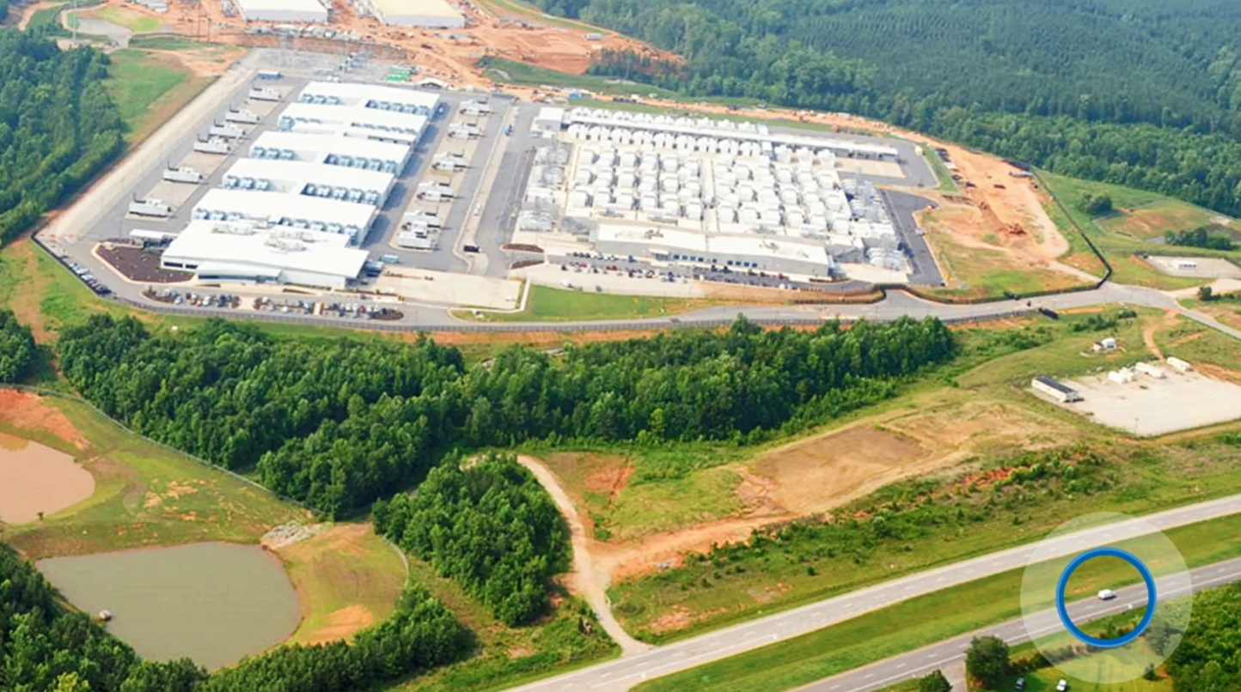

Slide 4
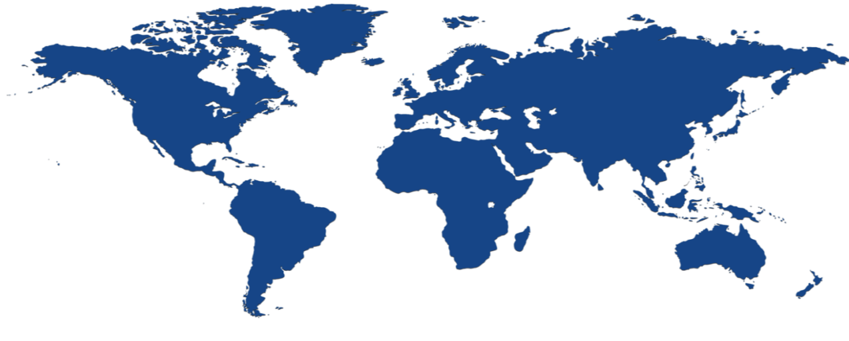


Microsoft Azure Locations
40 Cloud regions worldwide
United Kingdom South
North Central US
United Kingdom West
West Europe
West US 2
Central US
Canada Central
Germany Northeast²
US Gov Iowa
Canada East
North Europe
Korea Central
France³
Germany Central²
Korea South
West Central US
East US
France³
China West¹
Japan East
West US
US DoD West
Japan West
US Gov Arizona
East US 2
China East¹
US Gov Texas
US Gov Virginia
West India
South Central US
US DoD East
East Asia
Central India
South India
100+ datacenters
One of 3 largest networks in the world
¹China datacenters operated by 21 Vianet
²German data trustee services provided by T-systems
³France has been announced (due 2017)
⁴South Africa has been announced (due 2018)
Southeast Asia
Brazil South
S.Africa⁴
Cape Town
S.Africa⁴
Jo’Burg
Australia East
Australia Southeast
Global datacenters
Chinese datacenters
US Gov datacenters
German datacenters

Slide 5
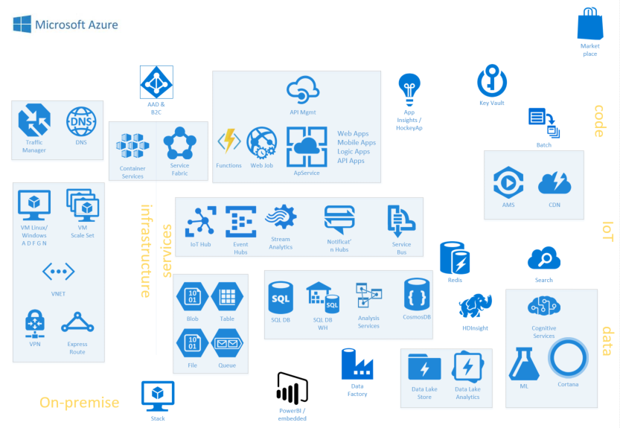

Slide 6


Infrastructure as a Service IaaS

Slide 7
The Hybrid Datacenter
Azure
Scale
Pay for what you use
Simple Dev / Test
Fast Provisioning
Integrated Operations
Automate
On-Premises Datacenter

Slide 8

IaaS
Network
Compute
Storage

Slide 9
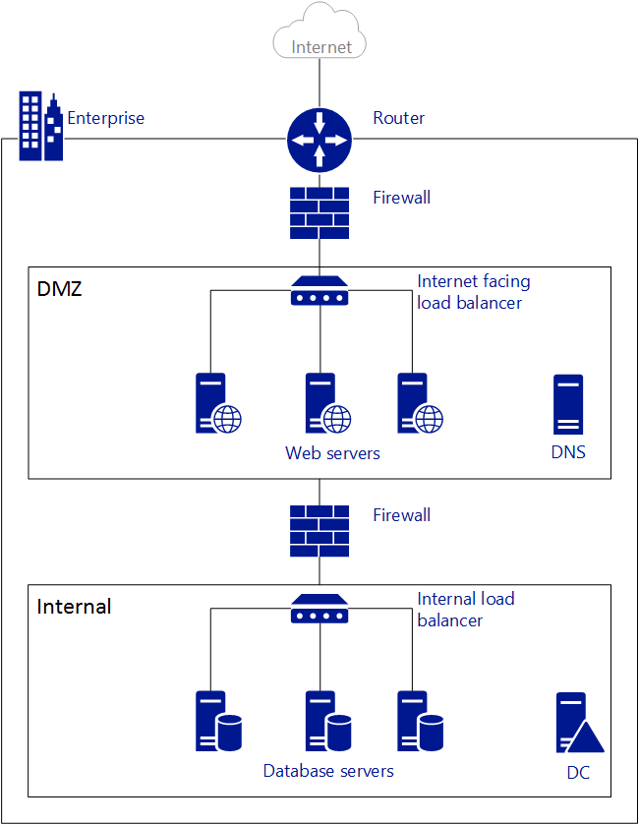
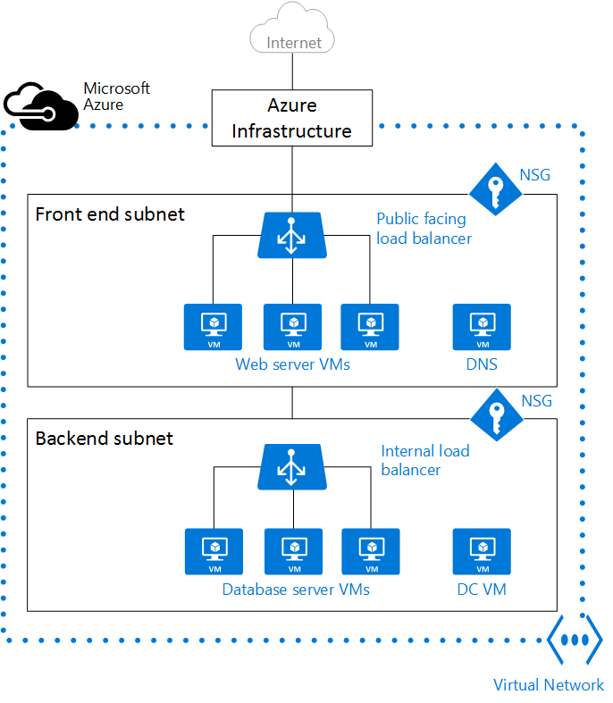
Networking
On Premise
Azure

Slide 10
Networking
On Premise Network | Azure Network
Router device | Azure infrastructure
Firewall appliance | Network Security Group (NSG)
Load Balancer device | Azure load balancer
Virtual Networks (VNet)
- Provide logical network isolation
Network Security Groups (NSG)
- Provide segmentation and control of traffic (filters)
- Traffic entering / leaving resources in a VNet controlled with NSG
VNets can be connected to each other and to on-premise datacentres
- VNet peering or network gateway
- Site to site VPN or ExpressRoute

Slide 11
Compute Family + (Version) + Size
Family | Description
A-series | cost-effective, general purpose compute
D(S) -series | cost-effective, general purpose compute (faster CPU and local SSD)
F(s)-series | best value compute capability per core, lower memory footprint
G(S)-series | highest memory footprint
H-series | very high end workloads (eg CFD)
L-series | low latency local storage (eg big data, SQL, NoSQL)
N-series | GPU-enabled. NV for visualisation, NC for compute
All apart from A-series have SSD temporary disk (D:\)
‘S’ indicates premium storage option (ie SSD for OS / Data drives)
- eg D1 (HDD) vs DS1 (SSD)
For some families there is a “v2” eg D2 -> Dv2 or DS2 -> DSv2
- This represents the next iteration, typically better specification
Machine family and size determine price
Not all machine sizes are available in all regions

Slide 12
Compute Families Examples
A2 or “Standard_A2”
2 CPU cores, 3.5GB Memory
135GB local HDD
Limit of 4 data disks
No premium storage option
A
DS4 or “Standard_DS4”
8 CPU cores, 28GB Memory
56GB local SSD
Limit of 16 data disks
Premium storage option
DS

Slide 13
Storage and Virtual Machines
Azure Virtual Machine
C:\
OS Disk
D:\
Temporary Disk
(Contents can be lost)
E:\, F:\, etc.
Data Disks
Azure Blob
Storage
Standard
Premium (SSD)

Slide 14

Availability & Scaling
Availability Set
Scale Set
Virtual Machine
Virtual Machine
Auto scale set of VMs
No pre-provisioning
Implicit availability set
1
SQL Server
Primary
SQL Server
Secondary
1
2
n
SLA 99.95
Deploy across fault / update domains

Slide 15
Platform as a Service PaaS

Slide 16
Platform as a Service
We provide services your application can use
We manage, maintain, upgrade, scale and generally look after these service automatically
You pay only for what you use
Very much along the ideas of microservice design, serverless computing
Popular ones:
Azure App Services for web sites
Azure SQL Database for SQL Server
Azure Functions for event code

Slide 17
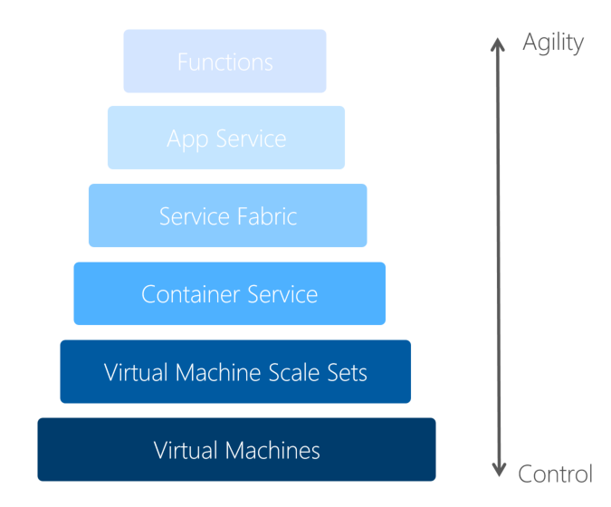
Code

Slide 18
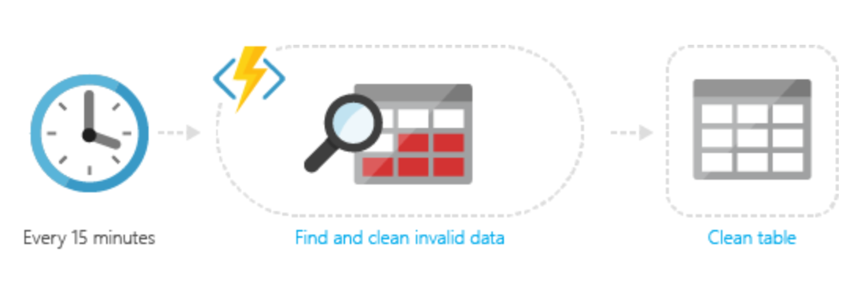
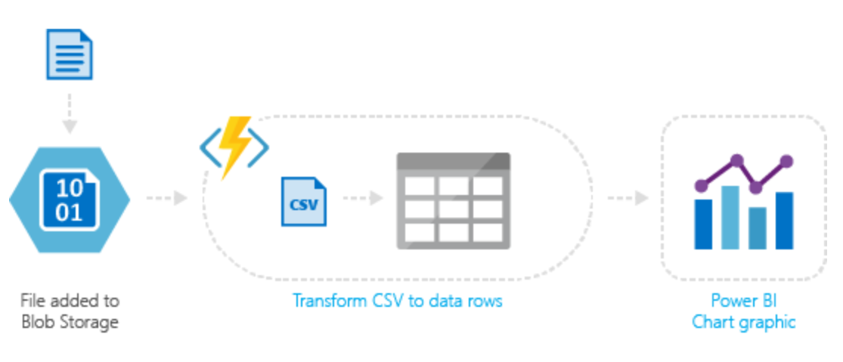
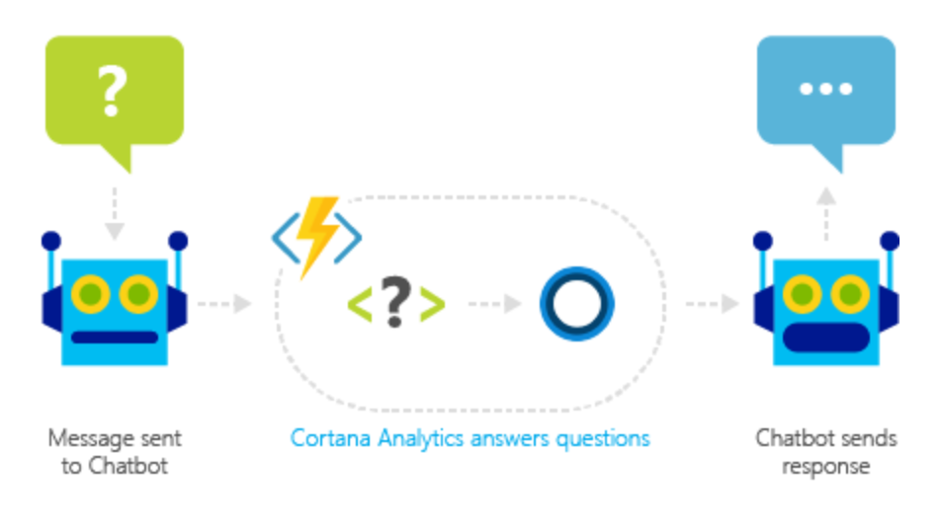

Azure Functions
Develop serverless architectures
Event driven model – timers, webhooks, queues, Service Bus, EventHub, …
Pay only for what you use
JavaScript, C#, Python, PHP, Bash, Batch, PowerShell or any executable
Functions runtime is open-source, available on GitHub

Slide 19
Data
Human derived data
(sales, orders, parts, invoices, inventory, etc)
Machine derived data
(telemetry, sensor, movement,
GPS, etc)
Transactional integrity, relational, etc.
Stand alone, variable quality, distributed, etc.

Slide 20
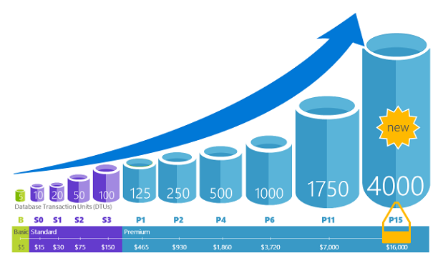
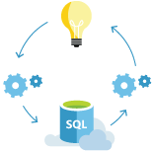
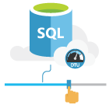
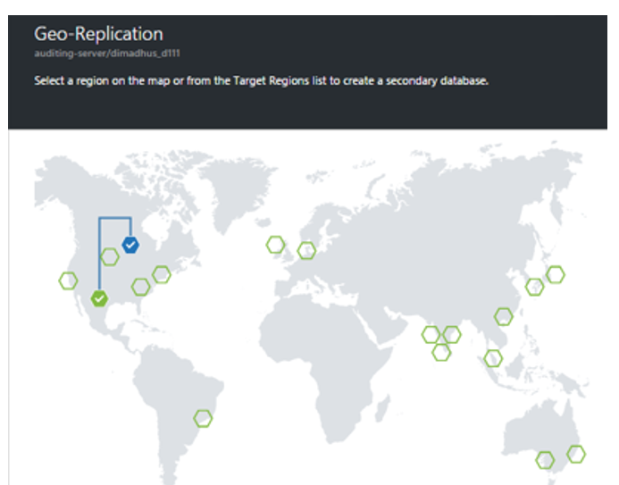
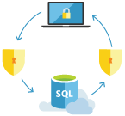
SQL Database
Relational database service with mission-critical capabilities, delivering predictable performance, scalability with no downtime, business continuity and data protection, all with minimal administration
“Database as a service”
Highly compatible SQL Sever engine
Scale performance on the fly, without app downtime via service tiers
Basic: 2 GB max size, 30 sessions
Standard: 250 GB max size, 200 sessions
Premium: 4TB max size, 400 sessions
Database Transaction Units (DTUs) workload
Point in time restore, Active Geo-Replication
New Azure Database Migration Service
PostgreSQL as a Service
MySQL as a Service

Slide 21
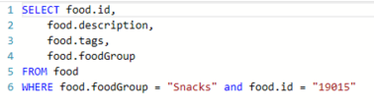

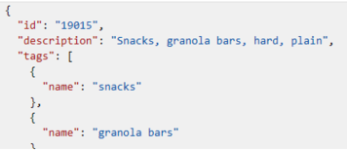

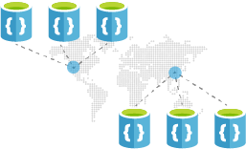
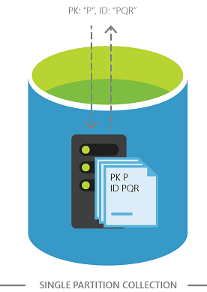
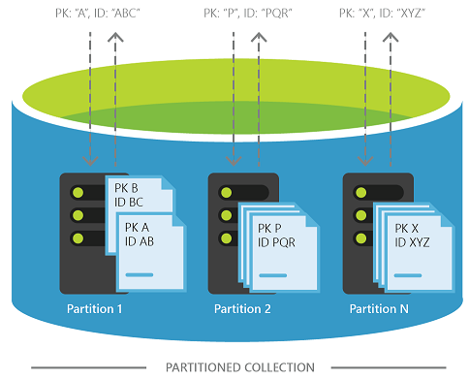
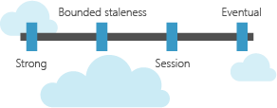
Azure Cosmos DB
Evolution of DocumentDB, as a blazing fast, planet-scale store
Replicate and scale data globally
Transparent partitioning
Replicates your data to any number of regions worldwide
APIs
DocumentDB NoSQL, MongoDB, Premium Table storage, Gremlin Graph, Spark
Guaranteed low latency
< 10 ms on reads, < 15 ms on writes
Choice of four consistency models
Strong, bounded staleness, session, & Eventual

Slide 22
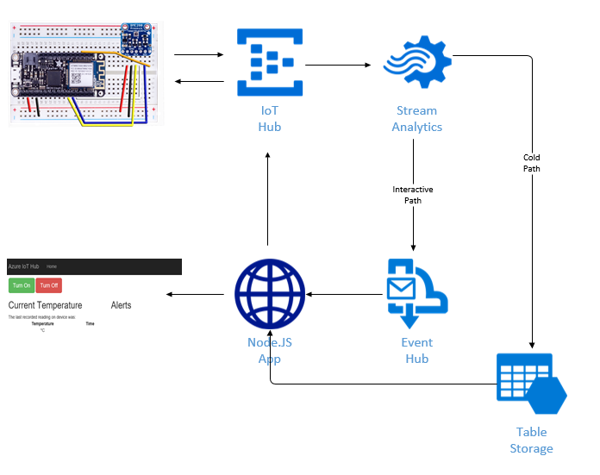
IoT

Slide 23
Azure Portal

Slide 24
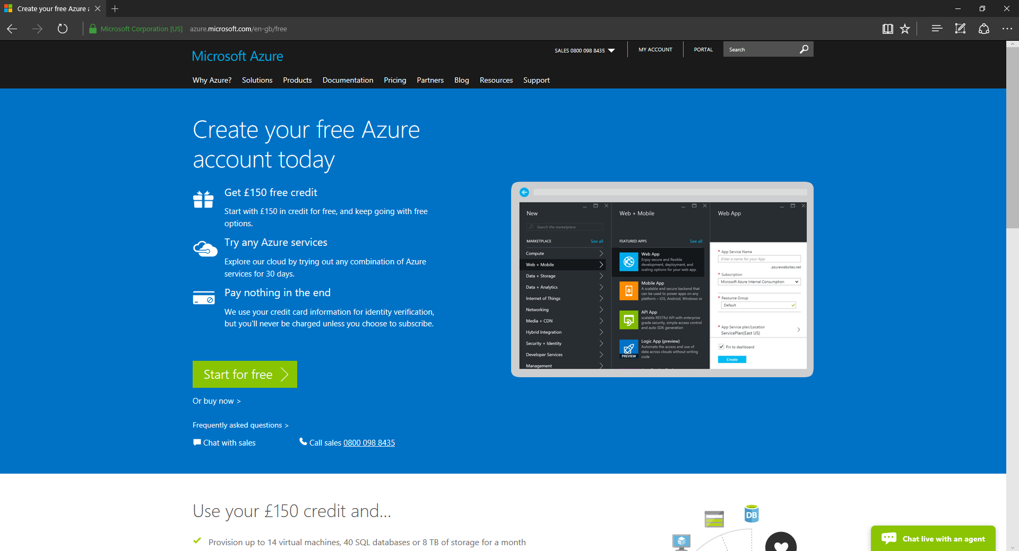
https://azure.microsoft.com/free/

Slide 25
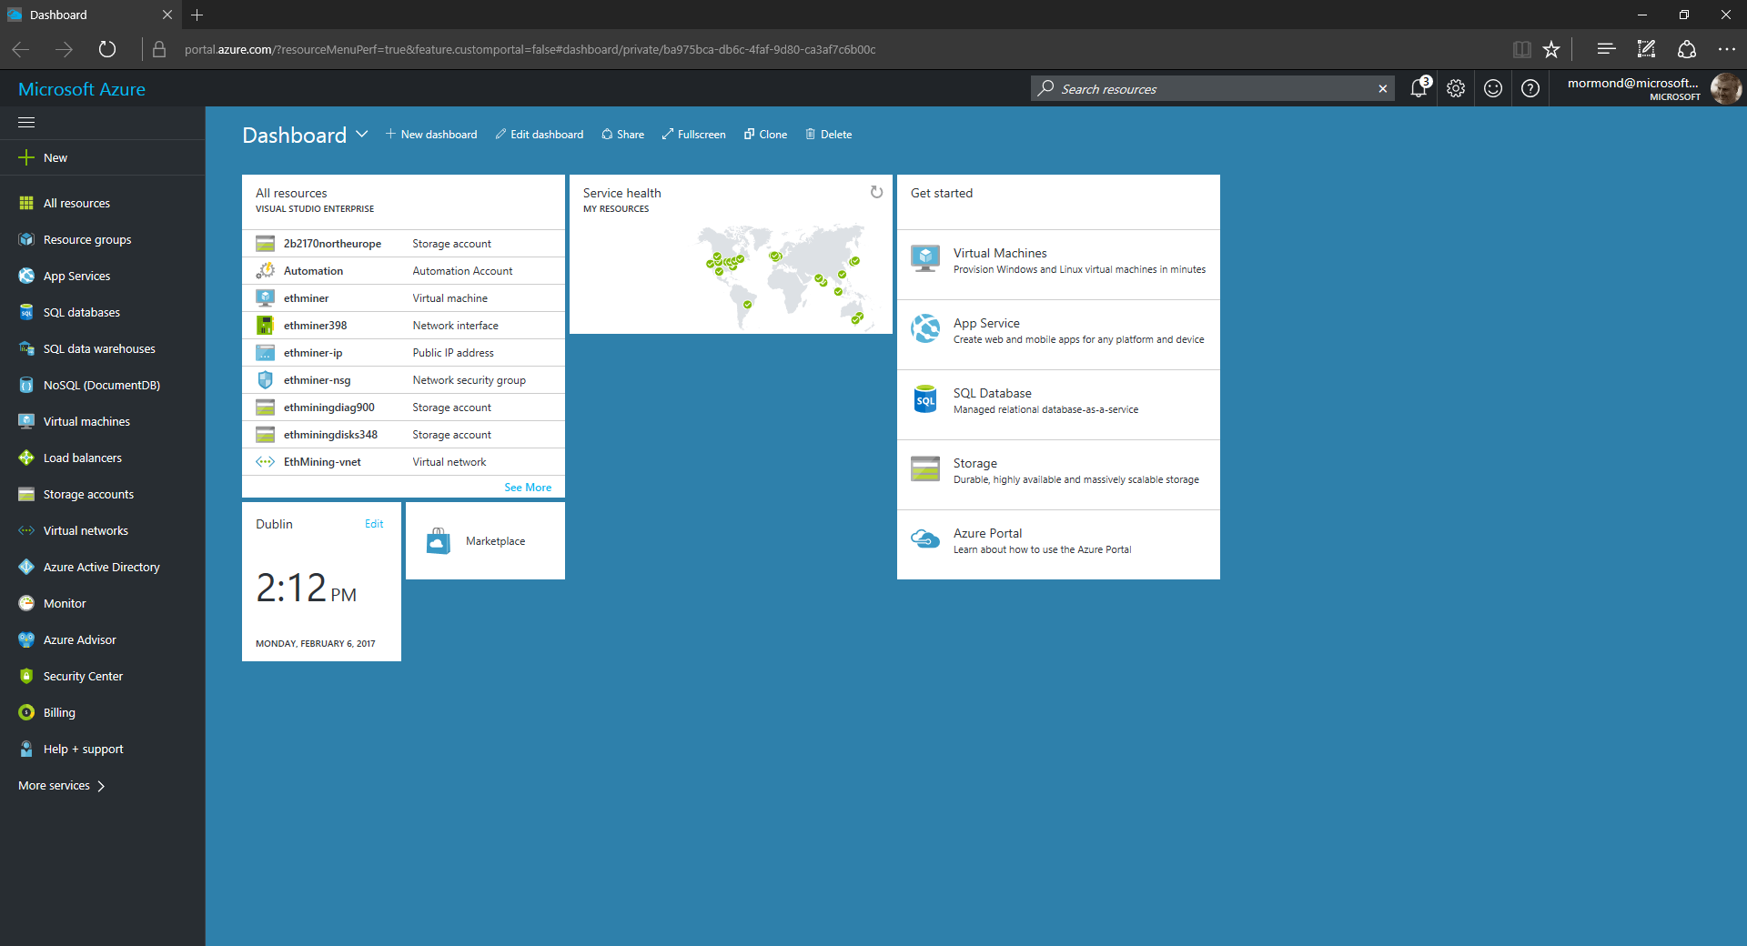
3
2
1

Slide 26
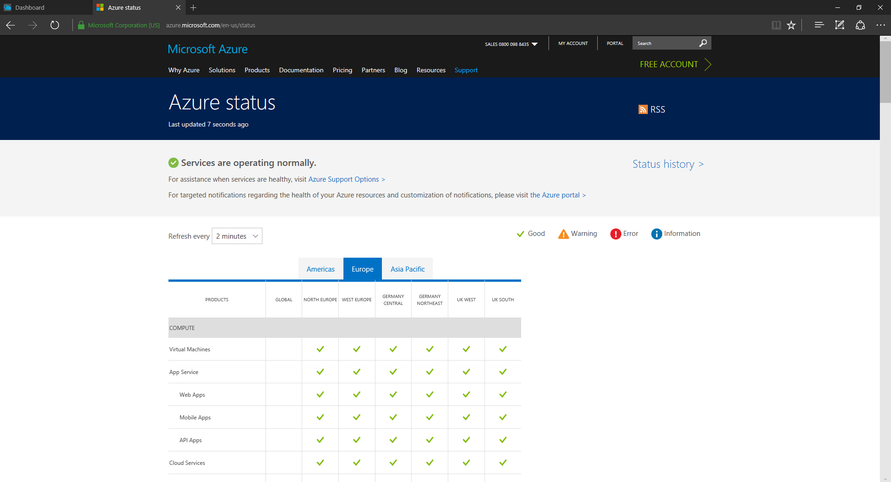
https://azure.microsoft.com/status/

Slide 27
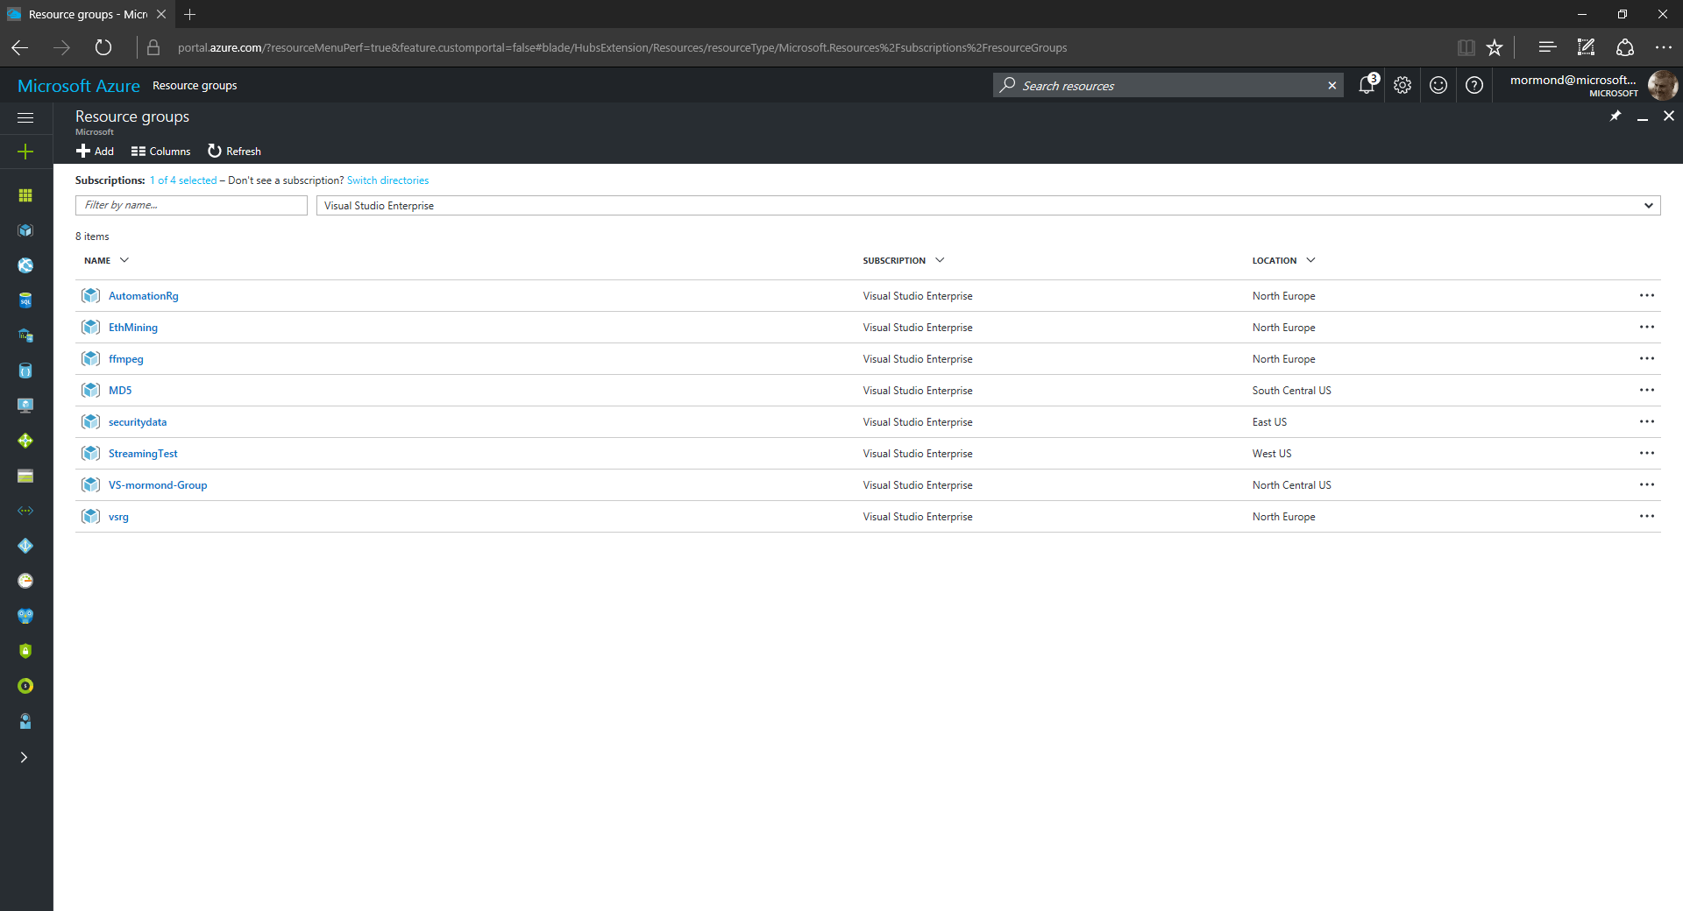

Slide 28


Slide 29
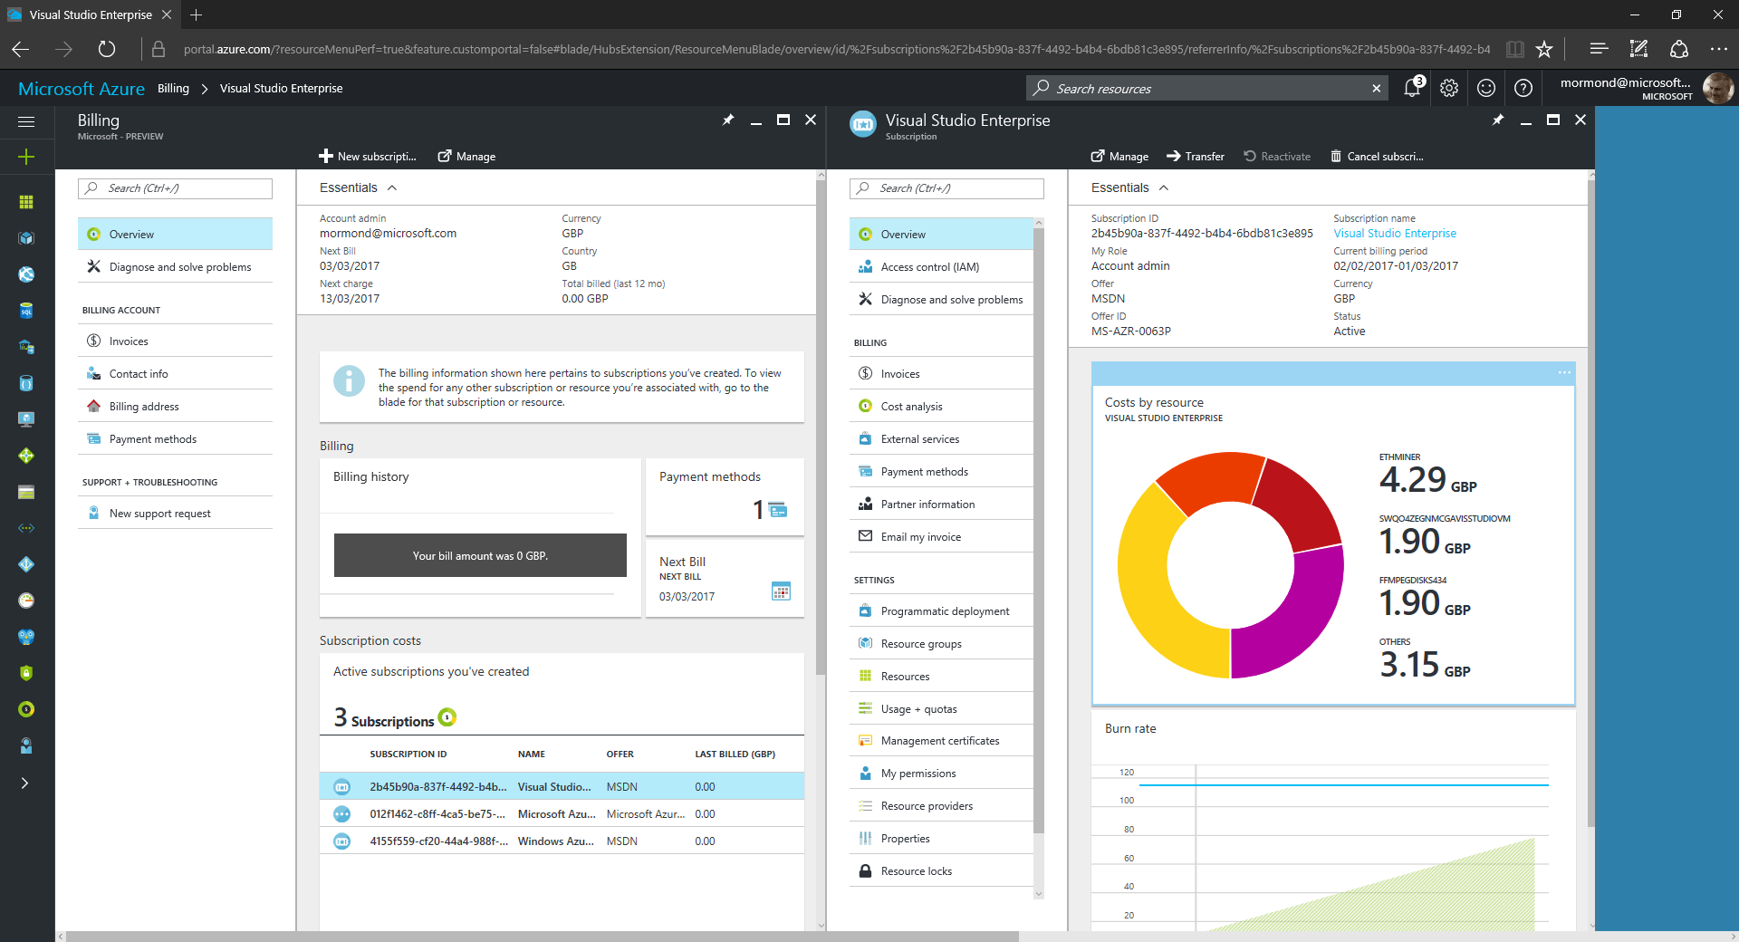
4
1
3
2

Slide 30
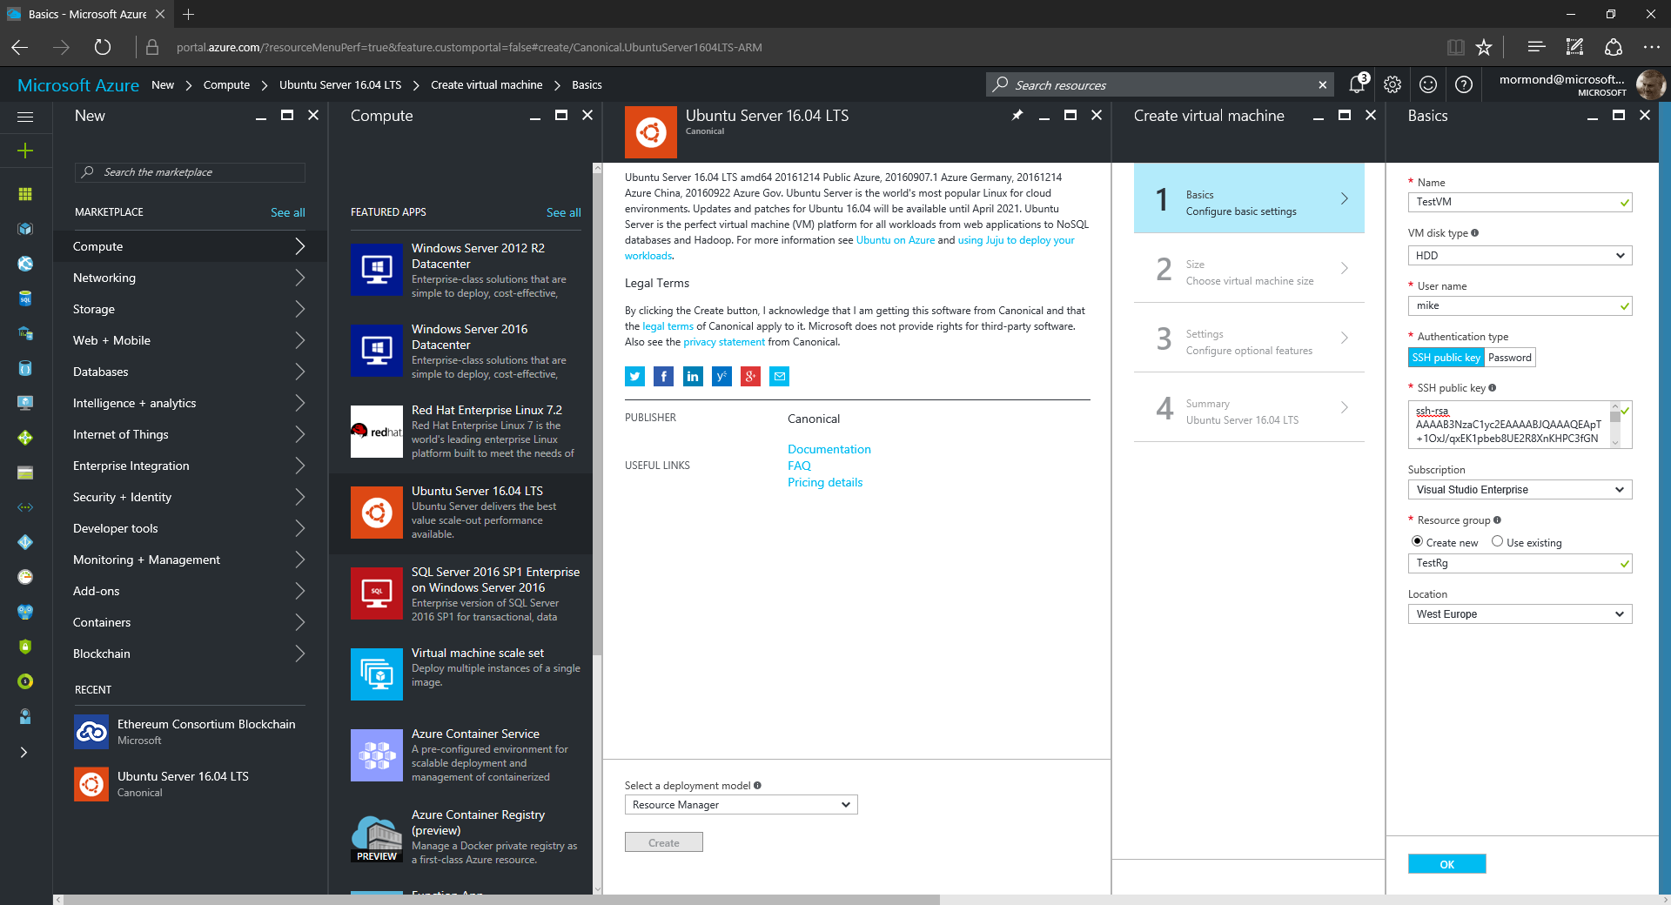
1
2
5
3
4
6

Slide 31
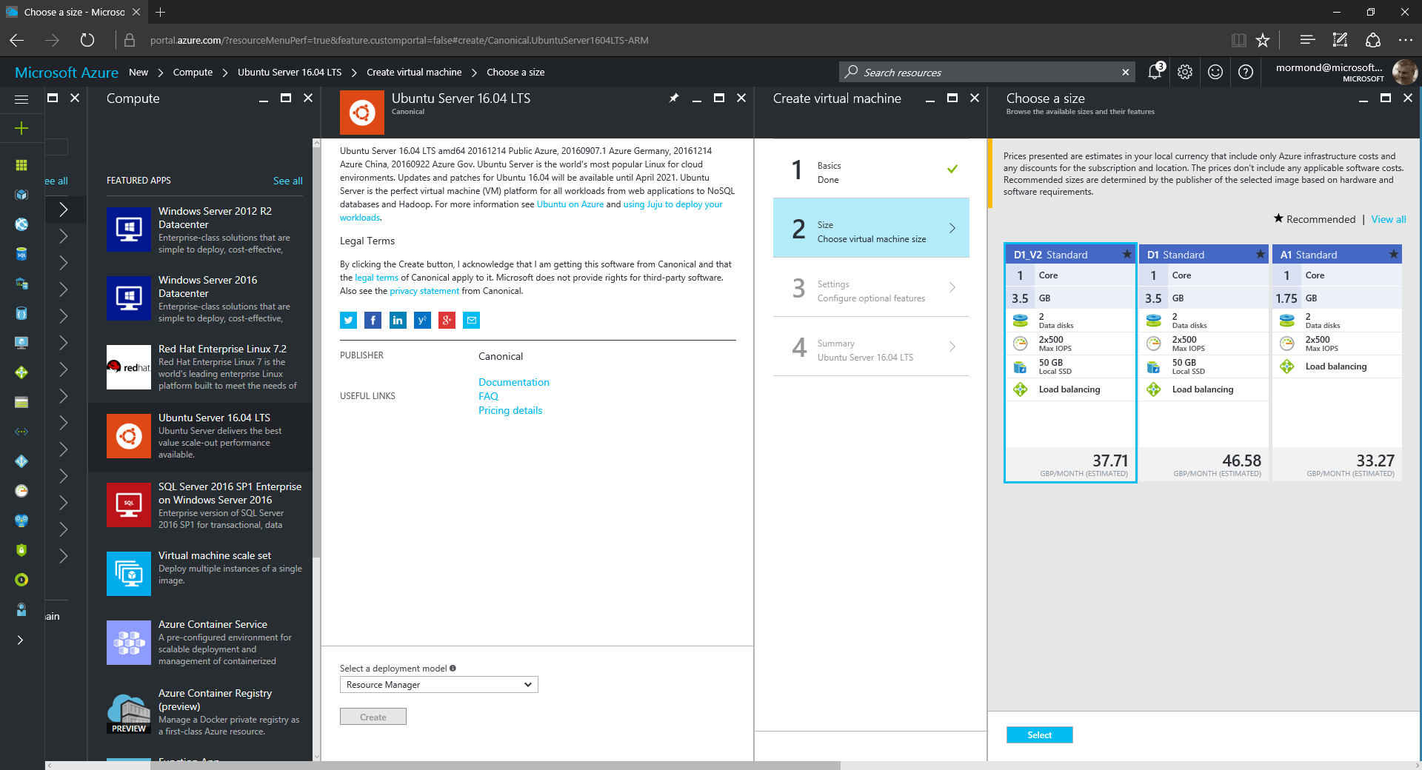

Slide 32
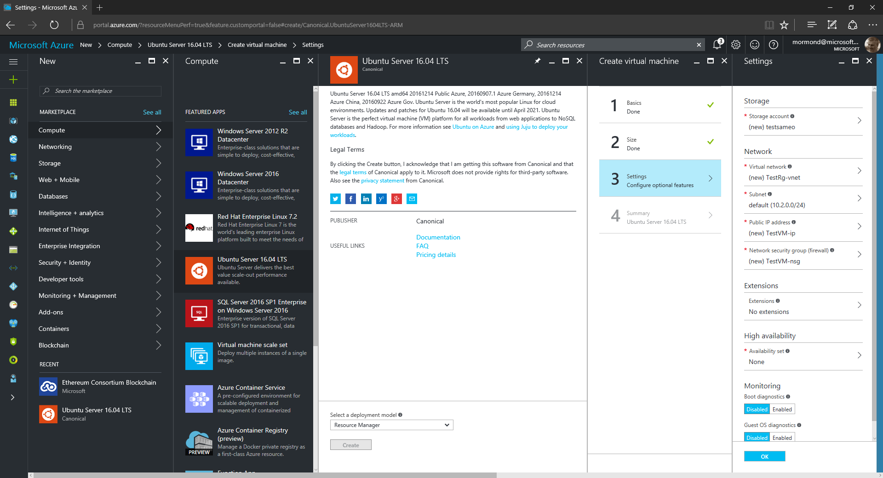

Slide 33
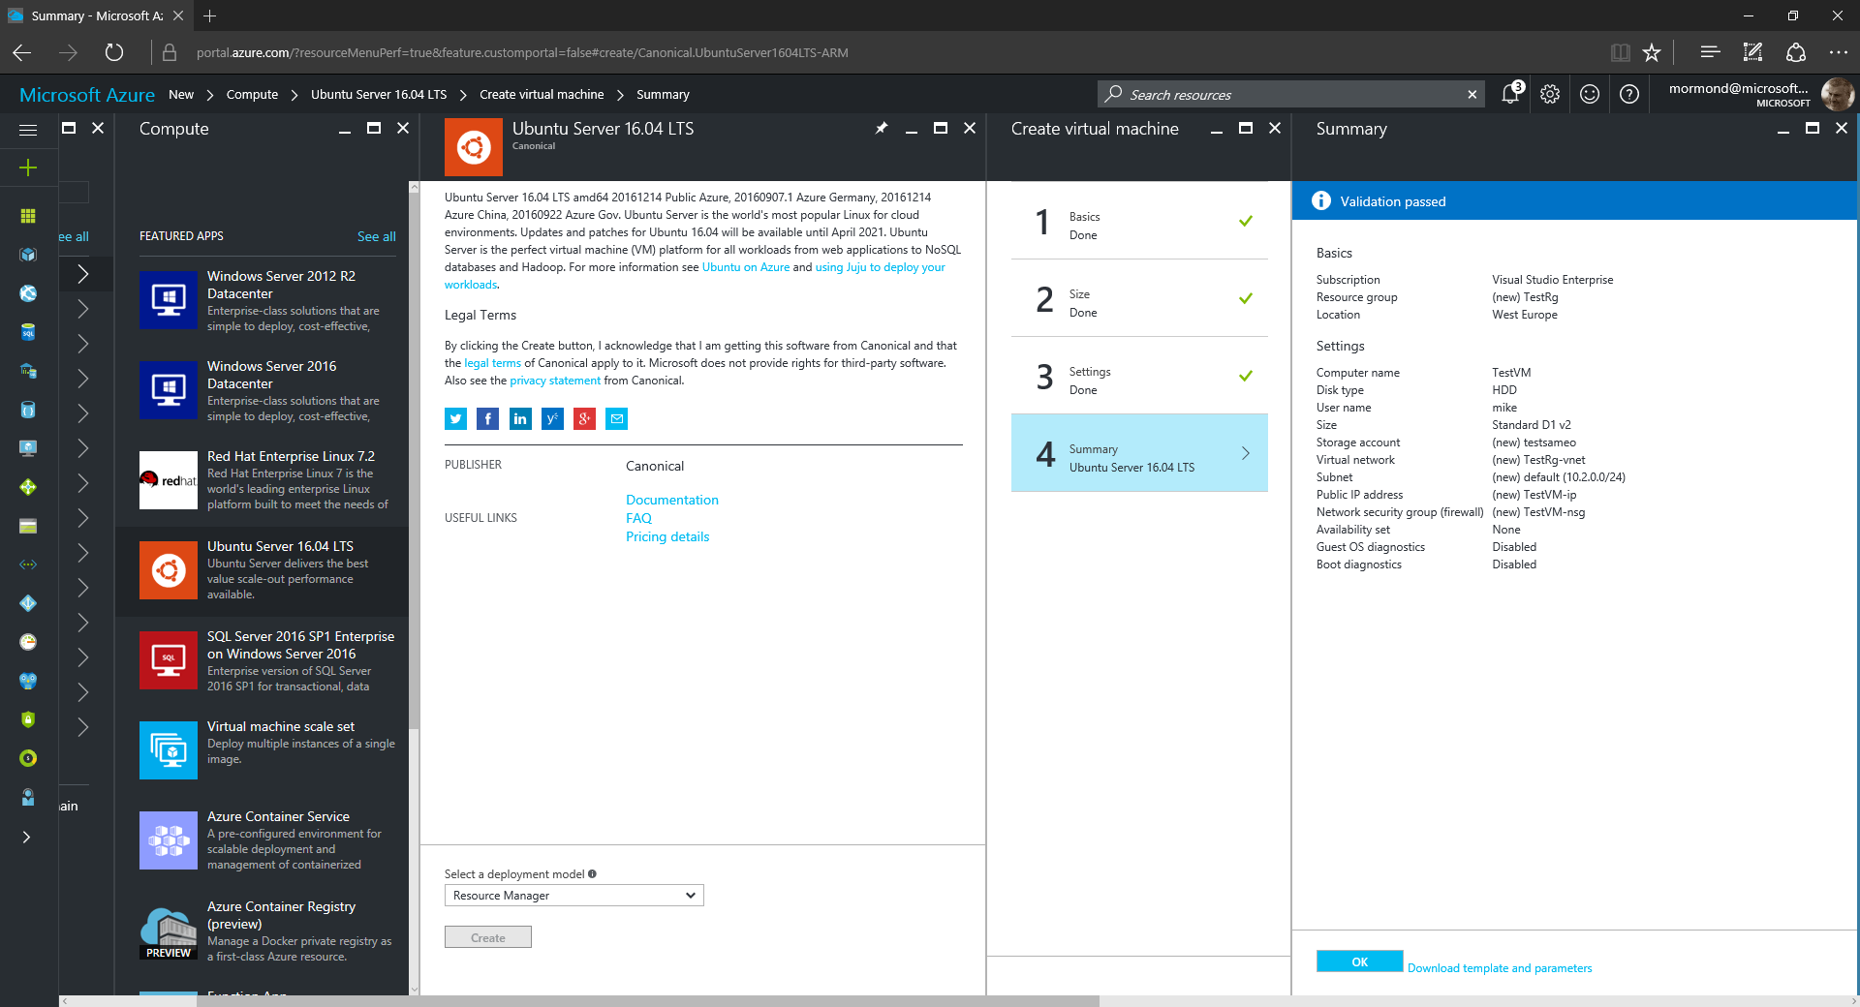

Slide 34
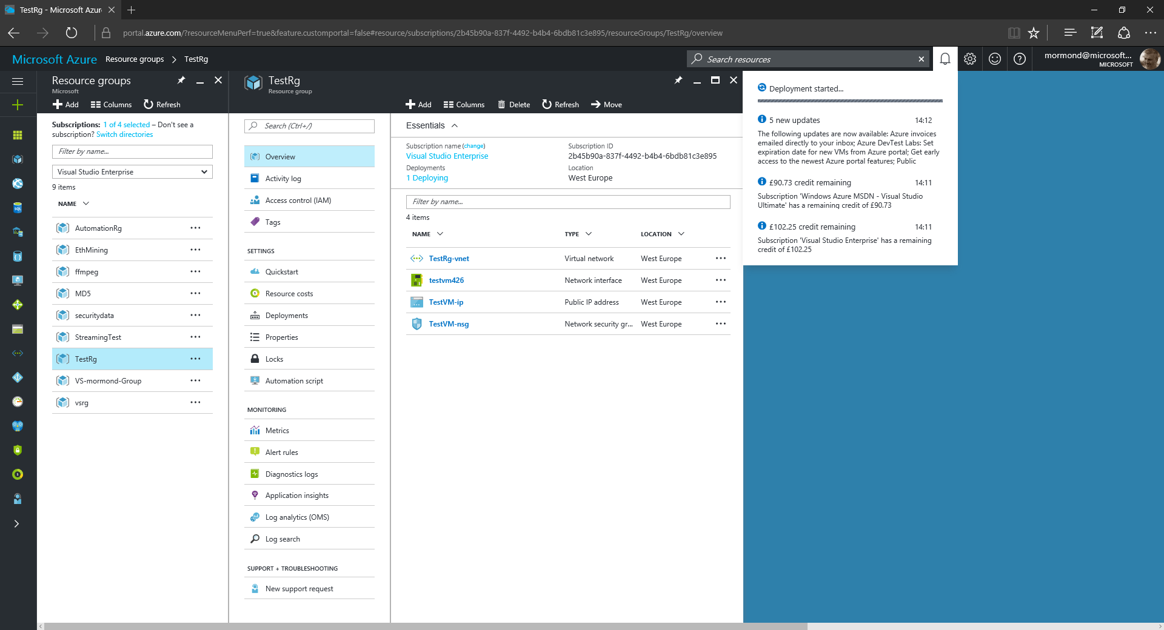
2
1

Slide 35
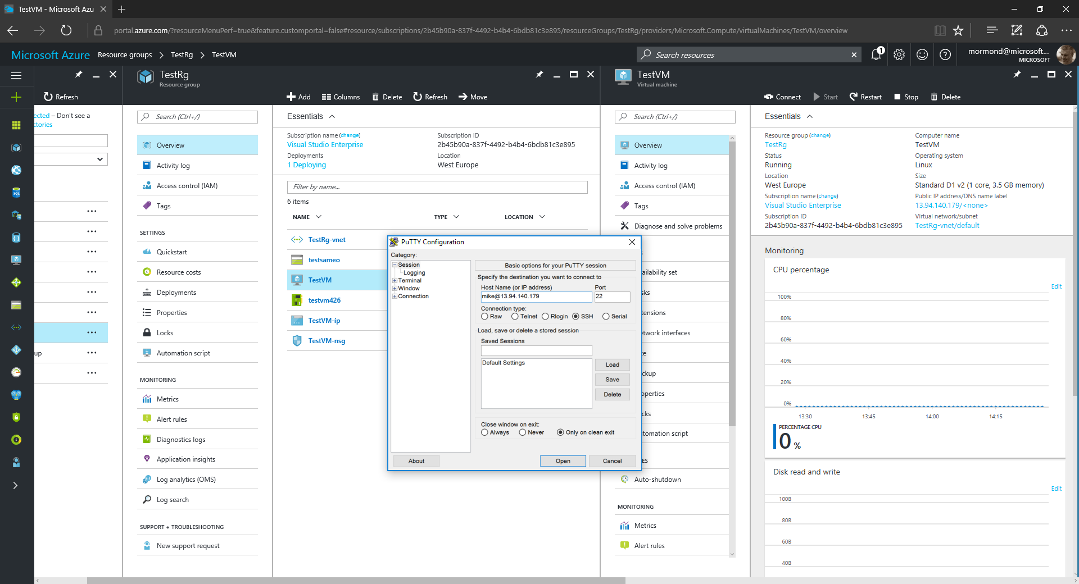

Slide 36
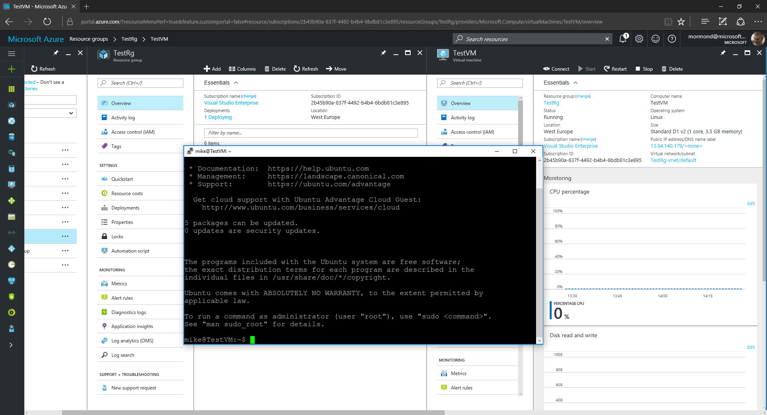

Slide 37
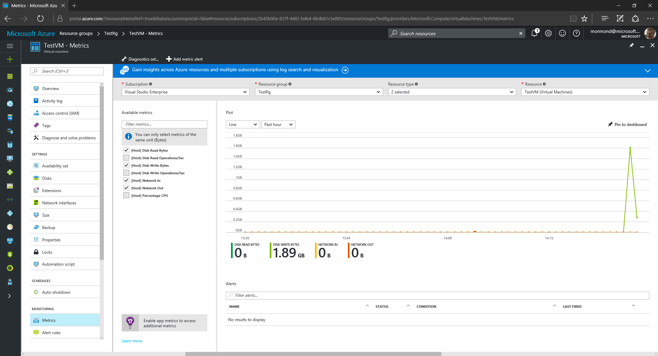

Slide 38
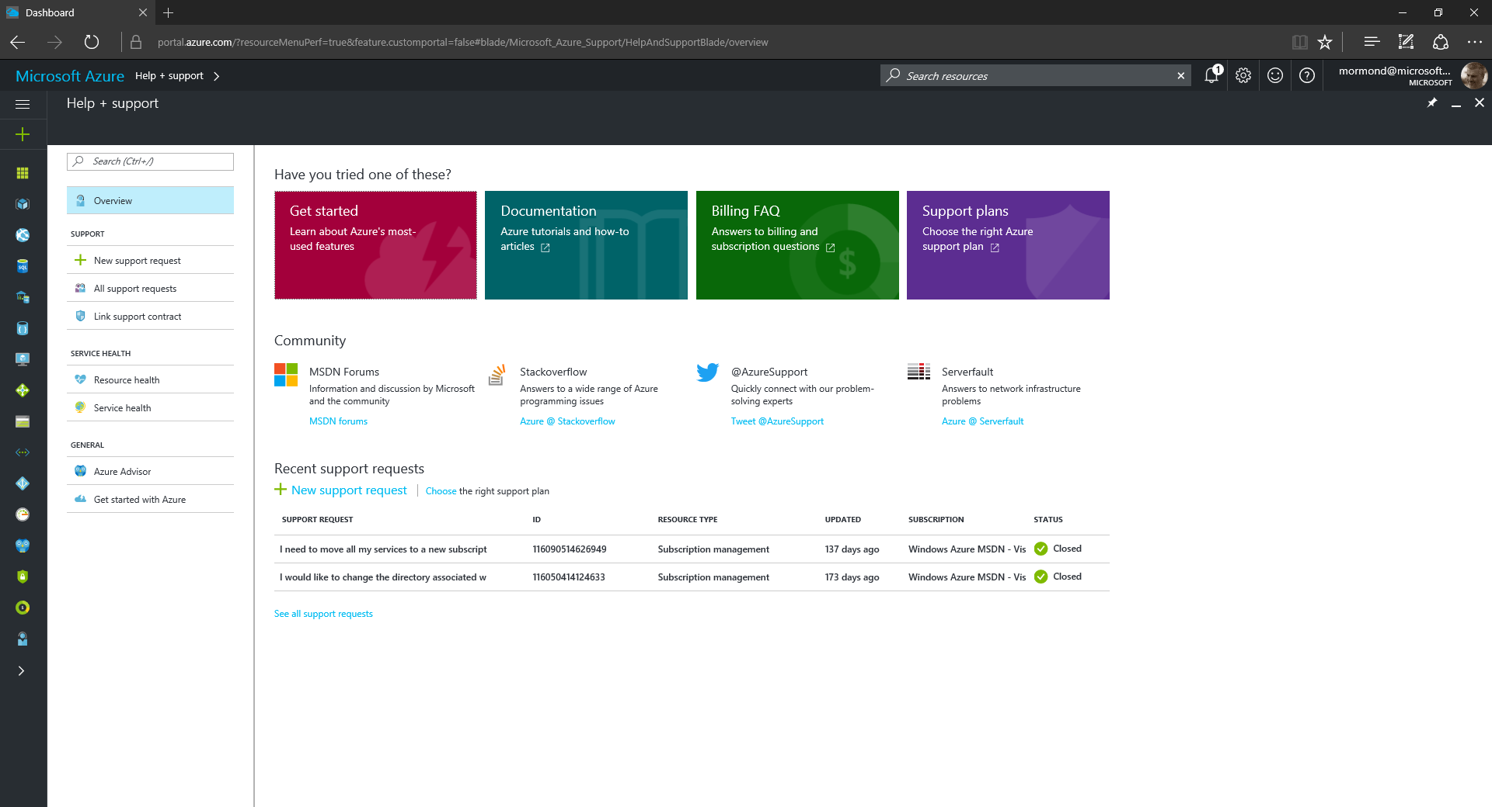
1
2

Slide 39
Summary

Slide 40
Useful resources
azure.microsoft.com is your starting place
azure.microsoft.com/free for your free trial
channel9.msdn.com/shows/Cloud+Cover &
channel9.msdn.com/Shows/Azure-Friday for great videos
azure.microsoft.com/blog for latest news

Slide 41
Thank you

